Slide 1

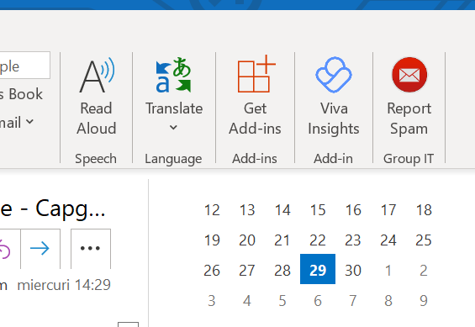
Social engineering: don’t become a phishing victim
“Phishing” emails appear to be from a legitimate source but trick you into providing personal information or credentials. Or could be emails that pretend to be someone else! “if it is too good, it might be a phising attack”

